Slide 1
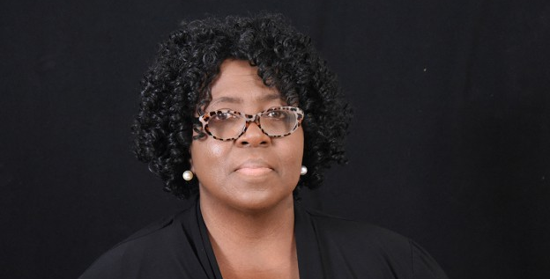
Growing Valley B.C. Dr George Rice Pastor 1686 Fuller Road, Minden, LA Celebrates Black History Month February 27, 2022, 9:15AM
Theme: Embracing Challenges and Moving Forward, Psalms 46: 1,2
Dr. Connie Walton, Guest Speaker
Grambling State University, Vice President of Academic Affairs and Provost

